Slide 1
CECS 326
Operating Systems
Process Synchronization
(Chapter 5, Operating system Concepts by Silberschatz, Galvin and Gagne)

Slide 2
Background
Processes can execute concurrently
Process executes instructions one after another, but may be interrupted at any time between instruction execution
Concurrent access to shared data may lead to race condition, resulting in data inconsistency
Maintaining data consistency requires mechanisms to ensure orderly execution of cooperating processes
Illustration of the problem:
  Previous solution to the producer-consumer problem leaves one slot unused to enable distinction between the conditions of full vs. empty buffer. This deficiency may be overcome by using an integer counter that keeps track of the number of filled buffer slots. The counter is set to 0 initially, incremented by the producer after each data it places in the buffer and decremented by the consumer after it removes a data from it.
Notes:
Race condition: caused by processes access to a shared memory => dẫn đến kq bị sai
Kết quả phụ thuộc vào thứ tự chạy xen kẽ process => kết quả có thể sai
Int count = 0
P1 đọc count = 0
P2 đọc count = 0
P1 ghi count = 1
P2 ghi count = 1
=> Count = 1

Slide 3
Producer-Consumer Problem
Producer
Consumer
while (true) {
/* produce an item in next_produced */
while (counter==BUFFER_SIZE);
/* do nothing */
buffer[in]=next_produced;
in=(in+1)%BUFFER_SIZE;
counter++;
}
while (true) {
while (counter==0);
/* do nothing */
next_consumed=buffer[out];
out = (out+1)% BUFFER_SIZE;
counter--;
/* consume the item in next_consumed */
}
Notes:
Counter: biến đếm có bao nhiêu item trong buffer
Counter++: producer bỏ thêm item vào
Counter--: producer remove iteam ra khỏi buffer

Slide 4
Race Condition
counter++ could be implemented as
(INC1) register1 = counter
(INC2) register1 = register1 + 1
(INC3) counter = register1
counter–- could be implemented as
(DEC1) register2 = counter
(DEC2) register2 = register2 - 1
(DEC3) counter = register2
Consider the following execution interleaving with counter = 5 initially:
  Producer execute INC1 (counter = 5, register1 = 5)
  Producer execute INC2 (counter = 5, register1 = 6)
  Consumer execute DEC1 (counter = 5, register2 = 5)
  Consumer execute DEC2 (counter = 5, register2 = 4)
  Producer execute INC3 (counter = 6, register1 = 6)
  Consumer execute DEC3 (counter = 4, register2 = 4)
  Value of counter is erroneous (correct value is 5) (This is race a condition)

Slide 5
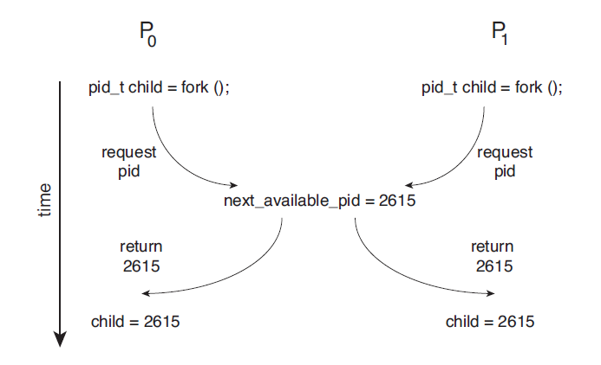
Race Condition

Slide 6
Critical Section (CS)
Cause of inconsistency in shared data counter is that it is manipulated concurrently by two processes
Process requires mutually exclusive access to shared data to ensure integrity
Section of code where such exclusive access is required is called Critical Section
Critical sections in the producer-consumer implementation:
  All statements where counter is referenced
Critical section problem is to design protocol to ensure that when one process is in its critical section, no other may be in its critical section
Notes:
Critical Section: đoạn code mà process có thể truy cập/thay đổi shared data
Ex: buffer[in] = next_produced;
in = (in + 1) % BUFFER_SIZE;
counter++;
=> đoạn này nằm trong critical section vì có đụng tới biến dung chung: counter, buffer[in]

Slide 7
Requirements of Solution to Critical-Section Problem
Mutual Exclusion – If process P_{i} is executing in its critical section, then no other process can be executing in their critical sections (turn)
Progress – If no process is executing in its critical section and some processes wish to enter their critical sections, then only those processes that are not executing in their remainder section can participate in deciding which will enter its critical section next, and this selection cannot be postponed ( no blocking - intention)
Bounded Waiting – A bound must exist on the number of times that other processes are allowed to enter their critical sections after a process has made a request to enter its critical section and before that request is granted
Notes:
Critical section có protocol (quy trình) bao gồm 3 điều kiện để thỏa là:
+ Mutual exclusion: tránh bị race condition dẫn tới kq sai
P1 đang trong critical section thì P2 phải đợi P1 xong thì P2 mới dc vào
+ Progress: tránh hệ thống bị đứng yên vì ko có process
Nếu không có process nào đang ở trong critical section, và có một số process muốn vào, thì hệ thống phải quyết định process nào được vào tiếp theo. Quyết định đó không được trì hoãn mãi mãi.
+ Bouned Waiting:
Một process đang chờ vào critical section thì không được chờ vô hạn. Phải có giới hạn số lần các process khác được vào trước nó.
P1 muốn vào critical section
P1 đang chờ
P2 vào
P3 vào
P2 vào lại
P3 vào lại
... => ko có Bounded Waiting thì P1 bị bỏ qua

Slide 8
Simple Algorithm (1) for Two Processes
Given processes P₀ and P₁
Use a shared variable “turn” to control which process can enter critical section
Initialize turn to 0
P₀ : P₁:
while (turn != 0) while (turn != 1)
/* do nothing */ ; /* do nothing */ ;
<critical section> <critical section>
turn = 1; turn = 0;
Problem with solution? Progress rule problem
Notes:
Thuật toán này đảm bảo Mutual exclusion => chỉ có 1 process được vào Critical Section
X: violate Progress rule
P0 vào Critical Section và đổi lượt cho P1, nhưng P1 giả sử ko muốn vào => ko ai đổi turn=0 để P0 có thể vào lại
=> P0 bị chờ vô lí

Slide 9
Simple Algorithm (2) for Two Processes
Given processes P₀ and P₁
Use shared Boolean array “flag” to control which process can enter critical section
Initialize both flag[0] and flag[1] to false
P₀ : P₁:
flag[0] = true; flag[1] = true;
while (flag[1]){ while (flag[0]){
flag[0] = false; flag[1] := false;
/* delay */ /* delay */
flag[0] = true; flag[1] := true;
} }
<critical section> <critical section>
flag[0] = false; flag[1] := false;
Problem with solution? Deadlock problem if flag[0] = flag[1] = true
Notes:
Thuật toán này bị Deadlock: là cả 2 process bị kẹt vì cứ chờ nhau
P1 muốn vào flag[1] = true, và P0 tương tự và cả 2 nhường nhau để vào critical section

Slide 10
Peterson’s Algorithm for Two Processes
Given processes P₀ and P₁
Use two shared variables
  int turn /* indicates whose turn it is to enter CS */
  Boolean flag[2] /* flag[i] = true indicates that process is ready to enter CS */
P_{i}:
do {
flag[i] = true;
turn = j;
while (flag[j] && turn == j) /* do nothing */ ;
<critical section>
flag[i] = false;
<remainder section>
} while (true);
Provable that the three CS requirements are met:
  Mutual exclusion is preserved (P_{i} enters CS only if either flag[j]= false or turn=i)
  Progress requirement is satisfied
  Bounded waiting requirement is met
Notes:
1 Process muốn vào Critical Section thì nó sẽ nhường cho Process còn lại vào trước

Slide 11
Critical Section Handling in OS
At any given time, many kernel-mode processes may be active in the OS
These processes may need to manipulate shared data structures (e.g., ready queue, wait queues for various resources, file descriptors) and hence are subject to possible race conditions
Two approaches are used to handle critical sections in OS:
  Preemptive kernel – allows preemption of process when running in kernel mode
  Non-preemptive kernel – a kernel-mode process runs until it exits kernel mode, blocks, or voluntarily yields CPU (essentially free of race conditions)
Notes:
Preemption : cho phép P1 bị interrupt khi đang chạy kernel mode
=> Require Synchronization to avoid race condition
Example
Suppose Process $P_{1}$is executing a system call:
P1 enters the kernel.
P1 updates a shared kernel data structure.
Before finishing, the scheduler interrupts $P_{1}$.
P1 is preempted.
Now Process $P_{2}$starts running and enters the kernel.
P2 accesses the same shared data structure.
If both processes modify the shared data without synchronization, a race condition can occur.
Therefore, preemptive kernels require synchronization mechanisms such as:
Mutexes
Spinlocks
Semaphores
Read-write locks
Advantages
Better responsiveness (cho phép CPU dừng Process này để sang Process khác quan trọng hơn)
Better support for real-time systems
Better CPU utilization
Disadvantage
More synchronization is required because race conditions are possible.

Slide 12
Synchronization Hardware
Many systems provide hardware support for implementing the critical section code
One HD solution could be disabling interrupts
  Currently running code would execute without preemption (not bad)
  Won’t work unless on a uniprocessor system, or all CPUs are disabled of interrupts at the same time. Too inefficient.
Modern machines provide special atomic hardware instructions that can be used to implement a “locking” mechanism
  Atomic means non-interruptible
  A “test_and_set” instruction to test memory word and set value
  A “swap” instruction to swap contents of two memory words
Notes:
Locking mechanism: prevent multi-process access the same time
Atomic: là instruction mà ko bị interrupt
2 instructions là test_and_set(), và swap()

Slide 13
A Simple Idea For N Processes
Given processes P₀, P₁,and P_{n-1}
Use a Boolean shared variable flag to indicate status of shared resource
  flag = true mean shared resource is available, OK to enter CS
  flag = false means shared resource is in use, DO NOT enter CS
  flag is initialized to true
P_{i}:
do {
while (!flag); /* keep testing, stay out until true */
flag = false; /* set flag to block out other processes */
<critical section>
flag = true; /* reset flag */
<remainder section>
} while (true);
Solution does not enforce mutual exclusion. Two or more processes may find flag = true, exit while loop, set flag to false, and enter CS
Notes:
Thuật toán này có thể bị interrupt => violate mutual exclusion dẫn đến race condition
Thuật toán test set:
Ban đầu P0 ktra while(!flag) thì flag dc set ban đầu là true nên cbi thoát
Chưa kịp thoát thì bị interrupt
P1 cũng ktra while(!flag) thì flag dc set ban đầu là true nên cbi thoát
P1 set flag = false để chặn ko cho process khác vào
P1 vào critical section
P0 tiếp tục và vào critical section
=> dẫn tới violation Mutual Exclusion gây ra Race Condition

Slide 14
A Simple Idea For N Processes (cont.)
Problem with this solution
  Operations for testing value of flag and setting it to a specific value can be interrupted
  For this idea to work, these operations must be atomic (indivisible)
  A “test_and_set” instruction is designed to meet this need
Definition:
Boolean test_and_set (Boolean *target){
Boolean rv = *target;
*target = TRUE;
return rv;
}
Executed atomically
Returns the original value of passed parameter
Set new value of passed parameter to true
Notes:
Test_and_set(): là atomic nên solve dc vấn đề bị interrupt

Slide 15
Solution Using test_and_set()
Shared Boolean variable lock, initialized to FALSE
Solution
do {
while (test_and_set(&lock)); /* condition not
right, stay out, keep checking */
< critical section >
lock = false;
< remainder section >
} while (true);
Notes:
Shared lock ban đầu là false => lock đang rảnh
FALSE = lock đang rảnh
TRUE = lock đang bị giữ
Dòng while(test_and_set(&lock)): thực hiện atomically Boolean rv = lock; // lấy giá trị cũ
lock = TRUE; // chiếm khóa
return rv; // trả về giá trị cũ
trả về giá trị ban đầu là False
=> While(false) thì process thoát vòng lặp và chiếm lock để vào critical section

Slide 16
Bounded-waiting Mutual Exclusion with test_and_set()
Given processes P₀, P₁,and P_{n-1} ; lock is a shared variable initialized to false
Code for P_{i}:
do {
waiting[i] = true;
key = true;
while (waiting[i] && key)
key = test_and_set(&lock);
waiting[i] = false;
< critical section >
j = (i + 1) % n;
while ((j != i) && !waiting[j]) /* find next waiting
j = (j + 1) % n; /* process & pass lock to it */
if (j == i)
lock = false;
else
waiting[j] = false;
< remainder section >
} while (true);
Notes:
waiting[i] = true; Process Pi wants to enter the critical section
while (waiting[i] && key): wait khi nào dk còn true thì chưa thoát vòng lặp
key=true: process chưa lấy dc lock và ngược lại
int j = (i + 1) % n;: tìm process muốn vào critical section theo circular order
j == i nếu ko có process nào mún vào đi, lock = false chưa bị khóa

Slide 17
Mutex Lock
Previous solution is complicated and generally inaccessible to application programmers
OS designers proposed new software tools to solve CS problem
The simplest is mutex lock
  CS is protected using acquire() and release(), which are defined based on a Boolean variable that indicates if lock is available or not
  Calls to acquire() and release() must be atomic, usually implemented via hardware atomic instructions
  This solution requires busy waiting. This lock is therefore called a spinlock.
Notes:
Busy waiting: Process liên tục gọi test_and_set()
Spinlock: mutex lock liên tục dùng busy waiting để kiểm tra (quay vòng) lock xem rảnh chưa để process chiếm lock

Slide 18
acquire() and release()
acquire() {
while (!available)
; /* busy wait */
available = false;;
}
release() {
available = true;
}
do {
acquire lock
< critical section >
release lock
< remainder section >
} while (true);

Slide 19
Semaphore – with busy waiting
Synchronization tool that provides more sophisticated ways than mutex locks for processes to synchronize their activities
Semaphore S
Can only be accessed via two indivisible (atomic) operations wait() and signal() (originally called P() and V() )
Definition involving busy waiting – S, an integer variable
  wait(S) {
  while (S <= 0)
  ; // busy wait
  S--;
  }
  signal(S) {
  S++;
  }
Notes:
Semaphore cho phép nhiều process/thread (tối đa bằng giá trị semaphore) truy cập tài nguyên cùng lúc
Còn Binary semaphore thì chỉ có 0 và 1 nên chỉ có tối đa 1 procss
----- có busy waiting ---------
Wait(): dùng để xin quyền dùng tài nguyên
Vd: S > 0 thì còn tài nguyên, process, và giảm S đi 1 rồi tiếp tục
S <= 0 thì process phải chờ
Signal(): dùng để trả lại tài nguyên (bằng cách tăng giá trị semaphore S++ và đánh thức process trong waiting queue)
Vd: Process đang giữ semaphore/tài nguyên sẽ gọi signal(). Process khác đang chờ sẽ chạy vòng wait().
P1

Slide 20
Semaphore Usage
Can solve various synchronization problems
For example, consider processes P₁ and P₂ that require S₁ to happen before S₂ :
  Create a semaphore “synch” initialized to 0
  P1:
  S₁;
  signal(synch);
  P2:
  wait(synch);
  S₂;
Notes:
To force statement S1 to happen before S2

Slide 21
Semaphore Implementation
Must guarantee that no two processes can execute wait() and signal() on the same semaphore at the same time
Thus, implementation of these operations becomes a critical section problem where the wait and signal code are critical sections
When a process is executing a long CS, other processes block themselves out of their CS in busy waiting occupying CPU non-productively. It is therefore desirable to have an implementation with no busy waiting.

Slide 22
Semaphore Implementation with No Busy Waiting
Each semaphore consists of an integer and a queue, defined as
typedef struct{
int value;
struct process *list;
} semaphore;
To eliminate busy waiting, the following two operations are needed:
  Block – place the process invoking the operation on an appropriate waiting queue
  Wakeup – remove one of the processes in the waiting queue and place it in the ready queue
Notes:
Block – place the process in waiting queue
Wakeup() – move waiting process to ready process

Slide 23
Semaphore Implementation with No Busy Waiting
wait(semaphore *S) {
S->value--;
if (S->value < 0) {
add this process to S->list;
block();
}
}
signal(semaphore *S) {
S->value++;
if (S->value <= 0) {
remove a process P from S->list;
wakeup(P);
}
}
Notes:
Busy waiting No busy waiting
Process liên tục kiểm tra Process bị block
Vẫn sử dụng CPU Nhường CPU
Không cần waiting queue theo kiểu block/wakeup Có waiting queue
Thường gọi là spinlock Dùng block() và wakeup()

Slide 24
Classical Problems of Synchronization
Problems that have different synchronization requirements:
  Bounded-buffer problem
  Readers and writers problem
  Dining philosophers problem

Slide 25
Bounded-Buffer Problem
A buffer with n slots, each can hold one data item
Semaphore solution:
  Semaphore mutex initialized to 1
    The mutex semaphore provides mutual exclusion for access to the buffer pool and initialized to the value 1.
  Semaphore full initialized to 0
  Semaphore empty initialized to n
    Empty and full semaphores counts the number of empty and full buffers.
Notes:
mutex = 1 được initialized ban đầu nghĩa là cho phép 1 process đi vào critical section
Empty = n còn bnhiu ô trống
Full = 0 có bnhiu item

Slide 26
Bounded-Buffer Problem - Semaphore Solution
Producer process
do {
...
/* produce an item in next_produced */
...
wait(empty);
wait(mutex);
...
/* add next_produced to the buffer */
...
signal(mutex);
signal(full);
} while (true);
Consumer process
do {
wait(full);
wait(mutex);
...
/* remove an item from buffer to next_consumed */
...
signal(mutex);
signal(empty);
...
/* consume the item in next_consumed */
...
} while (true);
Notes:
Các bài toán trước chỉ giải quyết vấn đề”Mutual exclusion”
Bài này cũng vậy nhưng them 2 điều kiện: Producer ko dc them khi buffer đầy, Consumer ko dc lấy khi buffer rỗng
Producer:
tạo item
Ktra buffer còn trống ko
Producer xin quyền truy cập buffer (wait(mutex) nếu mutex = 1 thì vào critical section. Mutex 1->0)
Thêm item vào buffer
Producer rời buffer và trả lại tài nguyên (signal (vì signal(S) S++. mutex 0 -> 1))
Thông báo Buffer có them 1 item (vì signal(S) S++. Full 0 -> 1)
Consumer:
wait(full): consumer ktra xem buffer có item ko (full > 0 thì full– rồi consumer đi tiếp, full < 0 thì wait tiếp)
Wait(mutex): consumer xin quyền vào buffer
Remove khỏi buffer
Consumer trả lại tài nguyên truy cập cho buffer (mutex 0->1)
Sau khi lấy ra thì empty++, buffer có them 1 ô trống

Slide 27
Readers-Writers Problem
A data set is shared among a number of concurrent processes
  Readers – only read the data set, they do not perform any updates
  Writers – can both read and write
Issues to address
  Allow multiple readers to read at the same time
  Only one single writer can access at a time
Several variations of how readers and writers are considered in providing their access, all involve some form of priorities
Shared data
  Data set
  Semaphore rw_mutex initialized to 1
  Semaphore mutex initialized to 1
  Integer read_count initialized to 0
Notes:
Rw_mutex, mutex đều là binary semaphore nên có 2 giá trị
1 = đang rảnh, có thể lấy lock
0 = đang bị khóa
mutex = 1, rw_mutex = 1, read_count = 0

Slide 28
Readers-Writers Problem
Reader
do {
wait(mutex);
read_count++;
if (read_count == 1)
wait(rw_mutex);
signal(mutex);
...
/* reading is performed */
...
wait(mutex);
read count--;
if (read_count == 0)
signal(rw_mutex);
signal(mutex);
} while (true);
Writer
do {
wait(rw_mutex);
...
/* writing is performed */
...
signal(rw_mutex);
} while (true);
Notes:
Wait(rw_mutex): reader xin dùng tài nguyên truy cập shared data (rw_mutex 1 -> 0). Writer sau đó gọi wait(rw_mutex) nhưng semaphore = 0 nên Write bị block
Reader:
đầu tiên Reader xin quyền vào critical section để update read_count (mutex 1 -> 0)
if (read_count == 1) wait(rw_mutex); nếu là reader đầu tiên thì nó khóa mutex để writer ko dc update
Signal(mutex) trả quyền truy cập cho reader khác
Reader đọc xong thì khóa mutex để reader_count-- an toàn
Ko còn reader_count nào (read_count==0) thì mở cho Writer vào bằng signal()
Writer:
Khóa rw_mutex trước khi ghi để ko có reader hay writer nào ko có quyền truy cập vào shared data
Trả lại quyền truy cập để Writer khác vào

Slide 29

Dining-Philosophers Problem
Philosophers spend their lives alternating thinking and eating
No interaction with neighbors. Occasionally try to pick up 2 chopsticks (one at a time) to eat from bowl. Need both to eat, then release both when done
Shared data, for the case with 5 philosophers
  Bowl of rice (data set)
  Semaphore chopsticks[5], all initialized to 1
Notes:
Nhiều process dung chung tài nguyên giới hạn
Dẫn đến bị Deadlock vì các Process chờ tài nguyên của nhau để tiếp tục chạy, nên bị kẹt

Slide 30
Dining-Philosophers Problem
Philosopher i
do {
// think
wait (chopstick[i] );
wait (chopStick[ (i + 1) % 5] );
// eat
signal (chopstick[i] );
signal (chopstick[ (i + 1) % 5] );
} while (TRUE);
Problem with this solution?
Notes:
Wait(chopstick[i]): mỗi ng lấy chiếc đũa đầu tiên => semaphore 1->0
Wait(choStick[(i+1)%5]) lấy chiếc bên phải, nma người thứ 2 bị chờ chiếc đũa bên trái của ng thứ 1 và những ng sau cũng chờ như vậy
Deadlock ở Wait(choStick[(i+1)%5])
Signal() ko dc chạy vì deadlock

Slide 31
Dining-Philosophers Problem
Deadlock handling
  Allow at most 4 philosophers to be sitting simultaneously at the table
  Allow a philosopher to pick up the chopsticks only if both are available (i.e., picking must be done in a critical section)
  Use an asymmetric solution – an odd-numbered philosopher picks up first the left chopstick and then the right chopstick, and even-numbered philosopher picks up first the right chopstick and then the left chopstick

Slide 32
Problems with Semaphores
Incorrect use of semaphore operations
  signal(mutex) … wait (mutex)
  wait(mutex) … wait (mutex)
  Omitting of wait (mutex) or signal (mutex) or both
Deadlock and starvation are possible
Notes:
Calling Signal(mutex) before wait(mutex)
Signal(mutex) PA:Signal(mutex) -> mutex=2 vì ban đầu mutex = 1 mà gọi signal trước nên khiên mutex++ => mutex = 2 => dẫn đến 2 process vào critical section cùng lúc
//critical section PB: Wait(mutex) -> mutex=1(enters)
Wait(mutex) PA:wait(nutex) ->mutex=0(enters)
2) Calling wait(mutex) twice
Mutex giống key, process nào lấy key trước thì vào critical section
Code đúng:
Wait(mutex) -> critical section -> signal(mutex)

Slide 33
Monitors
A high-level abstraction that provides a convenient and effective mechanism for process synchronization
Abstract data type, internal variables only accessible by code in procedures within it
Only one process may be active within the monitor at a time
But not powerful enough to model all synchronization schemes
Structure or a monitor
Monitor monitor-name
{
// shared variable declarations
procedure P1 ( … ) { … }
procedure P2 ( … ) { … }
Initialization code
}
Notes:
Monitor là cơ chế đồng bộ hóa để bảo vệ shared data và các hàm xử lí shared data
chỉ cho 1 process chạy trong monitor tại thời điểm
Monitor là 1 object class đặc biệt (Abstract data type, giống stack: chỉ dc gọi hàm trong stack ra dùng chứ ko quan tâm bên trong stack dùng gì)
+ biến: shared data
+ và hàm xử lí shared data

Slide 34
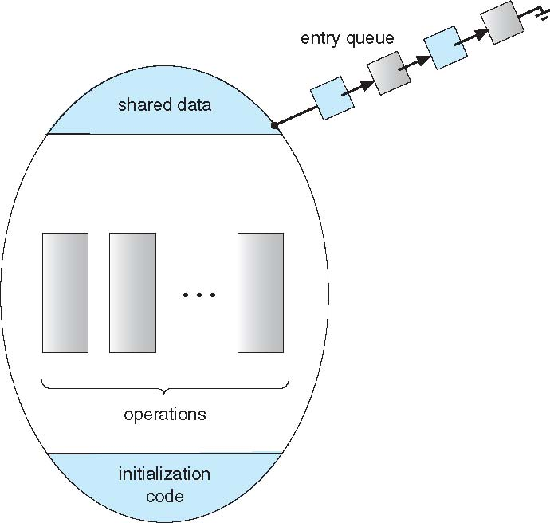
Schematic View of a Monitor

Slide 35
Condition Variables
Declaration
condition x, y;
Two operations are available on a condition variable x:
  x.wait() – a process that invokes this operation is suspended until x.signal()
  x.signal() – resumes one of the processes (if any) that invoked x.wait(). No effect if no x.wait() on the variable x.
Notes:
Condition variables: giống phòng chờ cho process/thread mà thoát khỏi monitor
x.wait(): process sẽ dừng và rời khỏi monitor và vào hàng đợi
x.signal(): đánh thức 1 process đang chờ và dừng ngay
Khác semaphore: semaphore có lưu giá trị S++ S– và quản lí truy cập bằng bộ đếm

Slide 36
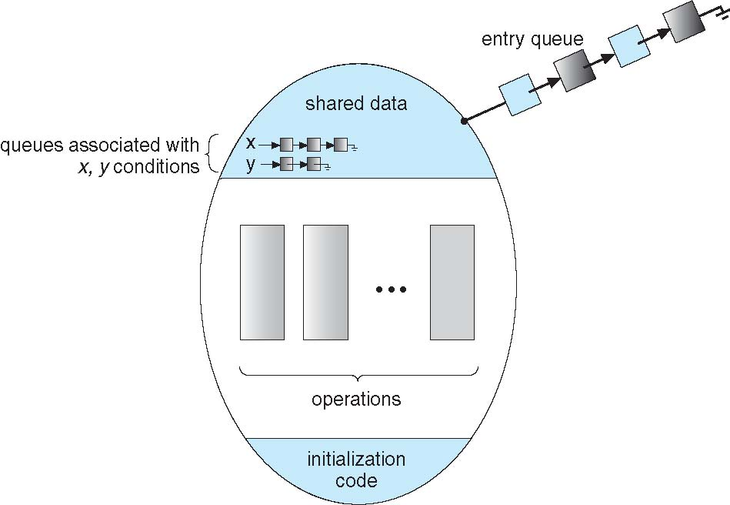
Schematic View of Monitor with Condition Variables

Slide 37
Choice of Implementation of Condition Variables
If process P invokes x.signal(), and process Q is suspended in x.wait(), what should happen next?
  Issue: both P and Q cannot execute concurrently. If Q resumed then P must wait
Options include
  Signal and wait – P waits until Q either leaves the monitor or it waits for another condition
  Signal and continue – Q waits until P either leaves the monitor or it waits for another condition.
  Both have pros and cons – language implementer can decide
  Monitors implemented in Concurrent Pascal compromise
    P executing signal immediately leaves the monitor, Q is resumed
  Implemented in other languages including Mesa, C#, Java
Notes:
Signal and wait: P gọi signal và Q chạy ngay. P vào hàng chờ until Q rời monitor hoặc wait
Concurrent Pascal: P gọi signal, P rời monitor ngay, Q chạy

Slide 38
Monitor Solution to Dining Philosophers
monitor DiningPhilosophers
{
enum { THINKING; HUNGRY, EATING) state [5] ;
condition self [5];
void pickup (int i) {
state[i] = HUNGRY;
test(i);
if (state[i] != EATING) self[i].wait;
}
void putdown (int i) {
state[i] = THINKING;
// test left and right neighbors, enable them to eat
// if hungry and waiting
test((i + 4) % 5);
test((i + 1) % 5);
}
Notes:
Condition self[5]: mỗi triết gia có hàng chờ riêng
Void pickup(): là hàm để triết gia xin phép bắt đầu ăn
Test(): kiểm tra 2 người bên cạnh có ăn ko, có đang ăn thì triết gia wait
Void putdown(): triết gia i ăn xong thì ktra xem 2 ng bên cạnh có đang ăn ko
self[i].wait(): triết gia i xin quyền ăn, chưa đủ dk nên ko dc ăn, thoát khỏi monitor để triết gia khác(process khác) có thể gọi putdown() rồi mới signal thì tiết gia i mới quay lại
=> Ko thoát monitor thì triết gia i sẽ đợi mãi mãi vì monitor chỉ cho 1 process vào

Slide 39
Solution to Dining Philosophers (cont.)
void test (int i) {
if ((state[(i + 4) % 5] != EATING) &&
(state[(i + 1) % 5] != EATING) &&
(state[i] == HUNGRY)) {
state[i] = EATING ;
self[i].signal() ;
}
}
initialization_code() {
for (int i = 0; i < 5; i++)
state[i] = THINKING;
}
}
Notes:
Hàm test(): check 2 ng bên cạnh có đang ăn hay ko
=> Ko ăn thì set self[i] của triết gia đang xin về state[i] = Eating và signal() cho triết gia đó để dc ăn

Slide 40
Solution to Dining Philosophers (cont.)
Each philosopher i invokes the operations pickup() and putdown() in the following sequence:
    DiningPhilosophers.pickup(i);
    EAT
    DiningPhilosophers.putdown(i);
No deadlock, but starvation is possible

Slide 41
Monitor Solution to Producer/Consumer Problem
monitor bounded-buffer
{
message B[N]; // message: a user-defined type
// N a predefined constant
int in, out, count;
condition nonfull, nonempty;
void place( message x) {
if (count == N) nonfull.wait;
B[in] = x;
in = (in + 1) % N;
count = count + 1;
nonempty.signal;
}
Notes:
message B[N]; B là mảng buffer
int in: vị trí producer sẽ ghi dữ liệu
out: vị trí consumer sẽ lấy dữ liệu
count: số phần tử hiện có trong buffer
condition nonfull: producer chờ ở condition khi buffer đầy và rỗng
nonempty; consumer chờ ở đây khi buffer rỗng
Void place(): dùng để producer đưa dữ liệu vào buffer
Ktra nếu buffer đầy thì nonfull.wait và thoát khỏi monitor để consumer vào
B[in] = x ghi dữ liệu vào vị trí in
%N là circular buffer để di chuyển dữ liệu sang ô tiếp theo

Slide 42
Solution to Producer/Consumer (cont)
void remove( message* x ) {
if (count == 0) nonempty.wait;
x = B[out];
out = (out + 1) % N;
count = count - 1;
nonfull.signal;
}
initialization_code() {
in = 0;
out = 0;
count = 0;
}
}
Notes:
Void remove(): lấy dữ liệu ra khỏi buffer
Ktra buffer rỗng thì consumer gọi wait(), consumer thoát ra monitor và vào hàng đợi
Initilization code: = 0 là ô đầu tiên và count = 0 là buffer đang rỗng

Slide 43
Solution to Producer/Consumer (cont)
Each producer invokes place() operation as follows:
  . . .
  produce message m;
  bounded-buffer.place (m);
  . . .
Each consumer invokes remove() operation as follows:
  . . .
  bounded-buffer.remove(m);
  consume message m;
  . . .

Slide 44
Resuming Processes within a Monitor
If several processes queued on condition x, and x.signal() is executed, which should be resumed?
FCFS frequently not adequate
Conditional-wait construct of the form x.wait(c)
  Where c is priority number
  Processes with lowest number (highest priority) is scheduled next
Notes:
First Come First Serve

Slide 45
Single Resource Allocation Problem
Allocate a single resource among competing processes using priority numbers that specify the maximum time a process plans to use the resource
    R.acquire(t);
    . . .
    Access the resource
    . . .
    R.release;
where R is an instance of type ResourceAllocator
Notes:
Mục tiêu: cho nhiều process sử dụng tài nguyên duy nhất sao cho 1 process dùng tại 1 thời điểm dựa trên mức độ ưu tiên
Giống semaphore nhưng Single resource thì có thêm mức độ ưu tiên
Acquire(t): t (time) càng nhỏ thì ưu tiên càng cao

Slide 46
A Monitor to Allocate Single Resource
monitor ResourceAllocator
{
boolean busy;
condition x;
void acquire(int time) {
if (busy)
x.wait(time); // processes queue in shortest
// job first order
busy = TRUE;
}
void release() {
busy = FALSE;
x.signal();
}
initialization code() {
busy = FALSE;
}
}
Notes:
Void acquire(): yêu cầu truy cập tài nguyên
Release(): set busy = false rồi signal() để resource đã rảnh và process có thể truy cập

Slide 47
Synchronization Example - Linux
Prior to kernel Version 2.6, disables interrupts to implement short critical sections. Version 2.6 and later, fully preemptive
Linux provides:
  Atomic integers
  Mutex locks
  Semaphores
  Spinlocks
  Reader-writer versions of both semaphore and spinlock
On single-CPU system, spinlocks are replaced by enabling and disabling kernel preemption

